Slide 1

UE23CS320B · PROJECT ID: 92
E.C.H.O – Efficient Contextualized History Orchestrator
Capstone Project Phase 2 · Progress Review #2
Project Guide: Dr. M. Shalima Sulthana
Project Team:
Arjun Sai N (PES2UG23CS091)
Mohammed Mir Fazlai Ali (PES2UG23CS346)
Mohammed Shehzaad Khan (PES2UG23CS349)
Mrigank Jain (PES2UG23CS352)

Slide 2

PROJECT SCOPE
What is E.C.H.O?
A local-first, intent-aware personal memory system that captures digital activity across Gmail, Chrome, and YouTube — unifying it into one searchable memory and reflecting on time usage without judgment.
The Problem
E.C.H.O's Answer
You research for an interview — receive emails, read articles, watch tutorials. A week later, it is scattered across Gmail, Chrome, and YouTube with no unified search.
One natural language query returns emails, web pages, and videos together — across all three sources simultaneously.

Slide 3
PROJECT SCOPE
What Echo Captures
Gmail
Chrome
YouTube
All emails saved on arrival — read and unread
Engagement tracking for opened emails
Thread context enrichment for replies
Attachments: PDF, DOC, DOCX, TXT, images (OCR)
Intent-filtered capture via custom MV3 Extension
Foreground time, scroll depth, interaction tracking
App pages (Slack, Jira) — session duration only, zero content extracted
Desktop Chrome browser videos tracked
Long-form and Shorts tracked separately
Metadata via YouTube Data API + best-effort transcript fetch

Slide 4

PROJECT SCOPE
Intent-Aware Capture — Not Everything is Saved
Gmail
YouTube Intent Gate — Any One Of:
No intent filter — all emails saved. Push-based; the user did not choose to receive them.
≥20 seconds foreground playback
Manual interaction: pause, seek, speed change, like
Revisit: same video opened earlier today (Redis 24hr memory)
Chrome — Two-Phase Gate
Phase 1: Page in foreground ≥ 5 seconds (exposure)
Phase 2: ≥10s active time / ≥25% scroll / interaction / revisit signal
Accidental clicks and quick glances are discarded. Only genuinely engaged content is saved.

Slide 5
PROJECT SCOPE
Three-Layer Storage Architecture
Layer
Technology
Role
Rebuildable
Permanent Truth
PostgreSQL 16+
All data — 15-table schema
NO
Semantic Search
FAISS (local)
384-dim vector index
YES — from PostgreSQL
Temporary Cache
Redis 7+
Revisit signals (24hr), attachment cache (1hr)
YES — disposable
PostgreSQL is the Single Source of Truth
FAISS & Redis are Fully Rebuildable
100% Local — Nothing in the Cloud
The only storage that cannot be recovered if lost. All other layers are derived from it.
Both can be regenerated entirely from PostgreSQL data at any time.
All storage resides on the user's machine. No permanent cloud data.

Slide 6
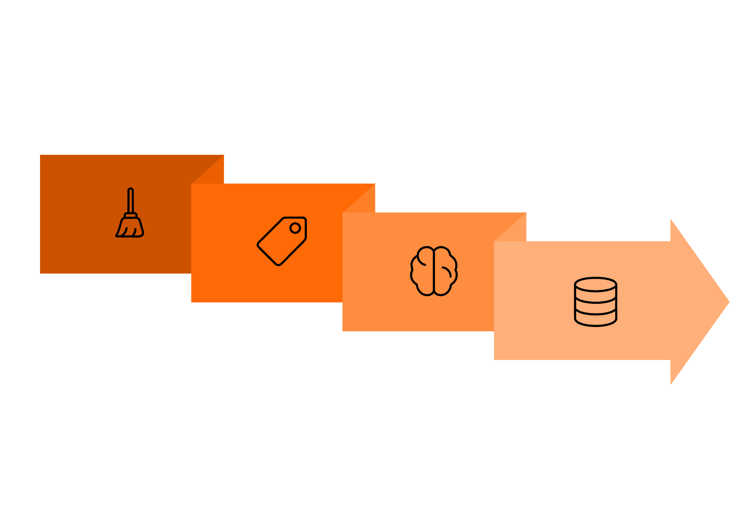
PROJECT SCOPE
Background Enrichment Pipeline
Runs entirely in the background — never blocks data capture. Crash-safe: raw data is already saved before enrichment begins.
Extract Keywords
Index & Flag
Source Clean
Generate Embedding
Each source is cleaned using its own method, then all items undergo keyword extraction, classification, embedding generation, and FAISS indexing.

Slide 7
PROJECT SCOPE
4-Stage System Group Classifier
Every item assigned exactly one of: work | study | entertainment | personal | misc. system_group_id is never NULL — fallback is always misc.
Stage 1 — Structural (~50%)
1
Gmail labels, YouTube categoryId, known domains → instant classification. Confidence 1.0, zero cost.
Stage 2 — Domain Lookup, Chrome (~25%)
2
200+ domain-to-category map. Ambiguous domains pass to Stage 3. Confidence 0.95, zero cost.
Stage 3 — Nearest Centroid (~15%)
3
Cosine similarity to 5 category centroid vectors. Centroids improve monthly. Zero cost.
Stage 4 — LLM Fallback (~10%, declining)
4
Batched title + 300-char snippet → LLM returns one label; feeds centroid update.

Slide 8

PROJECT SCOPE
LangGraph Retrieval & Synthesis Engine
LLM called exactly 2 times per query — everything in between is deterministic Python.
Call 1 — parse_intent
Self-Correcting Loop
Query + conversation history → structured JSON: sources, time_filter, query_clean, fetch_attachment flag.
Attempt 1
Deterministic Pipeline (No LLM)
Widen time window or open additional sources
postgres_search → faiss_search → evaluate_quality → widen_scope (max 3 attempts)
Attempt 2
Call 2 — synthesize
Remove all filters
Top-10 re-ranked results + attachments + history → readable answer with source citations.
Attempt 3
Full FAISS scan
After 3 failures: no_results_found message returned.

Slide 9
PROJECT SCOPE
Re-Ranking & Multi-Turn Queries
Multi-Signal Re-Ranking (Before Synthesis)
Multi-Turn Conversation Memory
40% — Semantic similarity (FAISS cosine score)
30% — Engagement depth (dwell time + scroll depth)
20% — Recency (exponential decay from last accessed)
10% — Effort score (revisits + completion rate + topic clustering)
Full chat history stored in local PostgreSQL, injected into every LLM call. Follow-up queries resolve references from prior turns.
Turn 1: "Find my TechCorp interview email" → returns email with timestamp T1
Turn 2: "Show Chrome pages about that topic after that email" → resolves topic and T1 from Turn 1

Slide 10
PROJECT SCOPE
Digital Wellbeing — Descriptive, Not Judgmental
Echo DOES
Echo DOES NOT
Show time by category: "You spent 2 hours on Shorts this week"
Reflect regret: "You marked 5 items as regretful"
Detect patterns: "Regret often occurs after 11 PM"
Score productivity or assign wellness scores
Judge behaviour or use prescriptive language
Predict addiction or block content
Session Analytics
Items within 5-minute gap = one session. Focus score and fragmentation metric computed per session.
LLM Privacy
Aggregated numbers only sent to LLM — never raw emails, pages, or video titles.

Slide 11
Project Scope: Regret System & User Groups
Title: Regret System & User-Defined Groups
Regret System:
Entirely user-declared — Echo never decides what is regretful
Each mark/unmark creates a new row — full toggle history preserved
Odd row count = currently regretted
Granularity: email-level (Gmail), page/session-level (Chrome), video-level (YouTube), session-level (Shorts)
User Groups (intent-based, e.g. "Capstone Project", "Placement Prep"):
Phase 1: user manually seeds ≥6 items
Phase 2: hybrid KNN + rule engine auto-assigns new items
Phase 3: weekly batch review every Sunday — user removes wrong assignments
Phase 4: KNN improves with each review cycle
Persistent group_rules: keyword / domain / channel / sender / time_window No item enters memory_user_groups without explicit human approval

Slide 12
Review 1: Suggestions & Responses
Suggestion 1: The presentation did not cover the full project scope and relied too heavily on verbal explanation.
Response: Slides 2–12 now explicitly cover the full scope of Echo, with every module, feature, and design decision shown on the slides.
Suggestion 2: Consider fine-tuning the LLM to improve results.
We did not fine-tune because small personal datasets often reduce generalization without improving personalization.
The scope issue made the system seem simpler than it was; once the architecture was fully shown, the panel confirmed the complexity was appropriate.
Instead, we improved results with LangGraph for stateful retrieval, memory, and deterministic execution.

Slide 13
Objectives
Title: Project Objectives
Unified cross-source search — one query returns emails, web pages, and videos together
Intent-aware capture — only content the user genuinely engaged with is saved
Deterministic retrieval — LangGraph RSE with LLM parsing once and Python executing all retrieval logic
Non-judgmental wellbeing — time patterns shown descriptively; no scoring, no blocking
Local-first privacy — all personal data stays on device; LLM receives only query snippets
Multi-turn conversational queries — follow-up questions resolve references from prior turns

Slide 14
Methodology: Ingestion Flow
Title: Methodology — How Data Enters Echo
Step 1: Data arrives (email / page visit / video watch) Step 2: Intent gate evaluated per source
Gmail: save immediately, no gate
Chrome: two-phase gate (exposure → engagement signals)
YouTube: playback gate (≥20s or manual interaction or revisit)
Step 3: If intent confirmed → INSERT into PostgreSQL (raw, crash-safe, atomic transaction)
memory_items + source_metadata + memory_engagement in one BEGIN/COMMIT block
Step 4: UNIQUE(source_type, source_id) constraint prevents duplicate ingestion on restart
Step 5: Enrichment Pipeline picks up preprocessed=FALSE records in background

Slide 15
Methodology: Enrichment & Classification
Title: Methodology — Enrichment Pipeline & Classification
Background worker — never blocks ingestion
Per item:
Text cleaned (HTML stripped, signatures removed, Readability for Chrome)
Keywords extracted
System group classified via 4-stage pipeline
384-dim embedding generated (all-MiniLM-L6-v2)
Embedding added to FAISS index
embedding_index table updated
preprocessed = TRUE set
4-Stage Classifier flow: Structural signals → Domain lookup → Nearest centroid → LLM fallback (batched)
Attachment processing (on-demand):
Triggered only when email ranks in top 3 and query suggests file content
Full text extracted → cached in Redis (1hr TTL) → binary never stored permanently

Slide 16
Methodology: LangGraph RSE Flow
Title: Methodology — LangGraph Retrieval Flow
Query enters → parse_intent (LLM Call 1) → structured JSON
postgres_search: SQL across memory_items + source metadata + engagement → up to 1,000 candidates
faiss_search: query embedded → cosine similarity within Postgres candidate IDs → top 20
evaluate_quality (pure Python, no LLM):
Checks: result count, source match, time window match, top result similarity score
Output: STRONG / WEAK / EMPTY
If STRONG → re-rank → check_attachments → synthesize (LLM Call 2) → answer
If WEAK/EMPTY → widen_scope → loop back (max 3 attempts) → no_results_found if all fail

Slide 17
Expected Deliverables: 8 Modules
Title: Expected Deliverables — Module Overview
Code
Module
GMC
Gmail Connector
CHC
Chrome Browsing Connector
YTC
YouTube Connector
STE
Storage Engine
ENP
Enrichment Pipeline
RSE
Retrieval & Synthesis Engine (LangGraph)
WBA
Digital Wellbeing & Analytics
UIL
User Interface Layer
All 8 modules are defined, scoped, and have assigned key files. Ingestion modules (GMC, CHC, YTC) have zero dependency on RSE — parallel development is possible.

Slide 18
Module Detail: Gmail & YouTube
Title: Module Detail — Gmail & YouTube
Gmail (GMC):
Gmail API OAuth 2.0 — polling and webhook support
All emails saved on arrival — engagement tracked via Chrome Extension when opened
Thread enrichment: reply emails inherit topic keywords from prior emails in thread
Two-tier attachment: lightweight extract always; full on-demand when ranked top 3
YouTube (YTC):
URL pattern detection: /watch?v= (long-form) and /shorts/ (Shorts)
Intent gate: ≥20s playback / manual interaction / revisit within 24hr
Shorts auto-classified as entertainment; regret at session level
Metadata: YouTube Data API v3 (title, channel, duration, categoryId)
Transcript: best-effort; title + description used as fallback

Slide 19
Module Detail: Chrome & Storage Engine
Title: Module Detail — Chrome & Storage Engine
Chrome (CHC):
Custom MV3 Extension — NOT Chrome History API (no engagement signals in History API)
Phase 1: ≥5s exposure. Phase 2: ≥10s foreground / ≥25% scroll / interaction / revisit
Canonical URL (UTM-stripped) used for revisit deduplication
Application pages: session duration only, zero content captured
Storage Engine (STE):
PostgreSQL CRUD across 15 tables, all with proper constraints and indexes
FAISS local index management — rebuild via embedding_index.is_active flag
Redis coordination — revisit TTL management, attachment cache
UNIQUE(source_type, source_id) on memory_items — restart-safe deduplication
Soft delete only: is_deleted = TRUE cascades to 6 subtables

Slide 20
Module Detail: Enrichment & Retrieval
Title: Module Detail — Enrichment & Retrieval
Enrichment Pipeline (ENP):
Polls preprocessed=FALSE queue continuously in background
Cleans text, classifies group, generates embedding, indexes FAISS
Attachment processing on-demand: PyPDF2 / pdfplumber / python-docx / Tesseract OCR
Retrieval & Synthesis Engine (RSE):
LangGraph stateful graph: 9 nodes, exactly 2 LLM calls per query
Conversation memory: PostgresChatMessageHistory — stored locally, never in cloud
Re-ranking: semantic (40%) + engagement (30%) + recency (20%) + effort (10%)
LLM plug-and-play: Anthropic / Google Gemini / Ollama — one config line to switch

Slide 21
Module Detail: Wellbeing & UI
Title: Module Detail — Wellbeing & UI
Wellbeing Analytics (WBA):
Time aggregation by system group and user-defined group
Session computation: 5-minute gap rule, focus score, fragmentation metric
Regret system: user-declared, 1:N event table, pattern detection by hour and day of week
User groups: manual seed → hybrid KNN + rule auto-assign → weekly review
LLM insights: aggregated numbers only — no raw content ever sent
UI Layer (UIL):
React 18+ dashboard: search, daily summary, heatmap, regret analytics, group management, settings
Chrome Extension popup: quick search, recent items, pause/resume toggle
FastAPI gateway: all backend routes consumed by frontend
Data export: JSON / CSV
Original emails accessible via iframe or link in search results

Slide 22
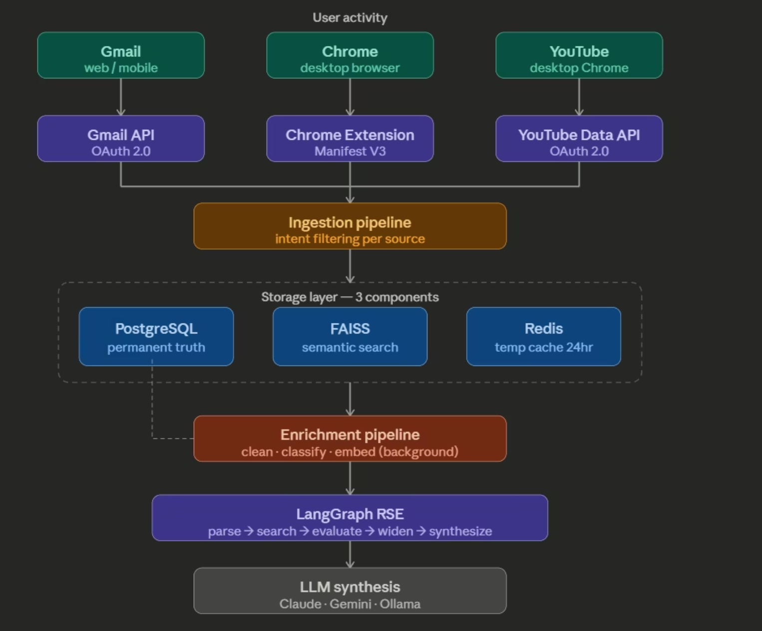
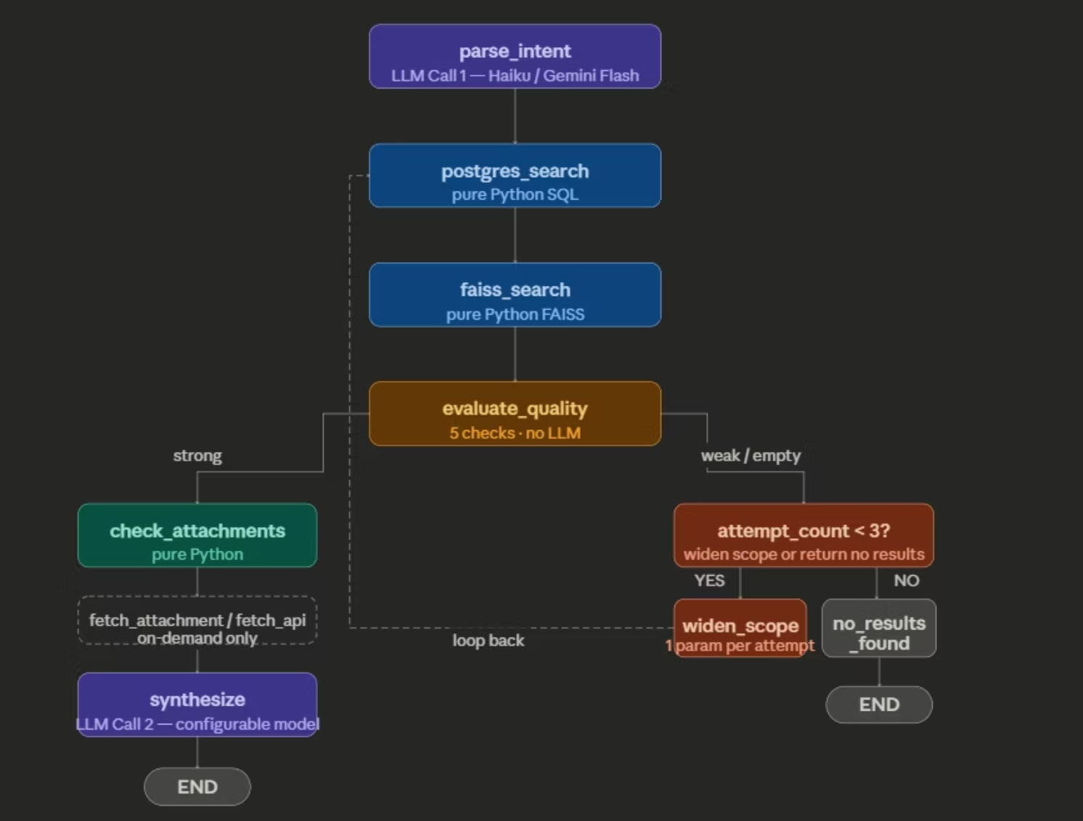

Slide 23
TITLE: INDIVIDUAL TEAM CONTRIBUTIONS
Individual Contributions
Title: Individual Team Contributions
Mohammed Mir Fazlai Ali (PES2UG23CS346):
YouTube ingestion module (YTC) — videos watched on test account recorded in PostgreSQL
Arjun Sai N (PES2UG23CS091):
Gmail ingestion module (GMC) — all sent/received emails recorded in PostgreSQL
Mrigank Jain (PES2UG23CS352):
Chrome browsing module (CHC) — tabs passing intent gate recorded in PostgreSQL
Mohammed Shehzaad Khan (PES2UG23CS349):
PostgreSQL schema (15 tables) on Neon, Redis caching on Upstash, Google Cloud OAuth & APIs configured, GitHub repo setup

Slide 24
SDKs, APIs & Tools
Title: Technologies Used
APIs & Cloud:
Storage & Infrastructure:
Gmail API v1 and YouTube Data API v3
Google Cloud OAuth 2.0
Anthropic Claude and Google Gemini APIs
PostgreSQL 16+ and Redis 7+
FAISS
Neon, Upstash and GitHub
Backend & ML:
Frontend & Extension:
Python 3.10+, FastAPI, SQLAlchemy
LangGraph and LangChain
sentence-transformers
React 18+ and TailwindCSS 3.x
Chrome Extension (Manifest V3)
Local LLM (offline option):
Testing:
Ollama with Llama 3.1 8B / Mistral 7B
pytest, Jest, Postman

Slide 25
10% Implementation: Foundation
Title: 10% Implementation — What Has Been Built
Foundation (Mohammed Shehzaad Khan):
15-table PostgreSQL schema live on Neon.tech — all tables, constraints, and indexes created
Redis running — revisit detection and attachment caching infrastructure ready
Google Cloud OAuth configured — Gmail API and YouTube Data API v3 fully authenticated
GitHub set up — all teammates have credentials to begin parallel development
All three ingestion modules functional and verified in PostgreSQL:
Gmail (Arjun) → emails live in PostgreSQL
YouTube (Mir Fazlai) → videos live in PostgreSQL
Chrome (Mrigank) → tabs live in PostgreSQL

Slide 26
10% Implementation: Justification
Title: Why This Constitutes 10%
The raw ingestion layer across all 3 sources is complete. This is the foundational 10% because:
The 15-table schema is the backbone every other module writes to and reads from
OAuth and API authentication are prerequisites for any data to enter the system at all
All 3 connectors are independently functional and verified — data is flowing into PostgreSQL correctly
Remaining ~90% to be built:
Enrichment Pipeline (text cleaning, classification, embeddings, FAISS indexing)
LangGraph RSE (9 nodes, LLM integration, conversation memory, re-ranking)
Digital Wellbeing module (analytics, sessions, regret, user groups)
React Dashboard and Chrome Extension popup
End-to-end integration, testing, performance benchmarking, and privacy audit

Slide 27
Any Other Information
Title: Any Other Information
FKCCI Inno Manthan:
Our team participated in FKCCI Inno Manthan — an annual startup presentation competition open to university and college students across Karnataka
We attended a two-day workshop as part of the competition and have been issued certified certificates for participation
We are the only team representing PES University in this competition

Slide 28
References
Title: References
[1] Y. Zhang, S. Liu, and J. Wang, "Are There Fundamental Limitations in Supporting Vector Data Management in Relational Databases? A Case Study of PostgreSQL," in Proc. IEEE Int. Conf. Data Eng. (ICDE), 2024, pp. 3640–3653.
[2] R. Islambouli, S. Ingram, and D. Gillet, "Understanding Digital Wellbeing Through Smartphone Usage Intentions and Regrettable Patterns," in Proc. IEEE Int. Conf. Healthcare Informatics (ICHI), 2024.
[3] N. Reimers and I. Gurevych, "Sentence-BERT: Sentence Embeddings using Siamese BERT-Networks," in Proc. Conf. Empirical Methods Nat. Lang. Process. (EMNLP), 2019.
[4] J. Johnson, M. Douze, and H. Jégou, "Billion-Scale Similarity Search with GPUs," IEEE Trans. Big Data, vol. 7, no. 3, pp. 535–547, 2021.
[5] M. Kleppmann et al., "Local-First Software: You Own Your Data, in Spite of the Cloud," in Proc. ACM SIGPLAN Symp. New Ideas, New Paradigms, Reflections Program. Softw. (Onward!), 2019, pp. 154–178.
[6] V. Kostakos, A. Giannoulis, and M. Langheinrich, "Privacy-Preserving Data Storage and Processing: A Survey of Modern Approaches," ACM Comput. Surv., vol. 54, no. 6, 2021.
[7] Y. Sun, A. Dubey, and E. P. Xing, "Lifelong Learning with Retrieval-Augmented Memory," in Proc. Adv. Neural Inf. Process. Syst. (NeurIPS), vol. 33, 2020.
[8] V. Karpukhin et al., "Dense Passage Retrieval for Open-Domain Question Answering," in Proc. Conf. Empirical Methods Nat. Lang. Process. (EMNLP), 2020.

Slide 29
Thank You
E.C.H.O — Efficient Contextualized History Orchestrator Project ID: 92 | Guide: Dr. M. Shalima Sulthana

